Slide 1
Francesco Pupillo, Goethe University Frankfurt
REINFORCEMENT LEARNING
𝛿
CIMCYC Workshop Computational modelling of behavioral data
Granada, 2nd June 2022

Slide 2
Part 1 – Basic Concepts
CIMCYC Workshop Computational modelling of behavioral data
Granada, 2nd June 2022

Slide 3
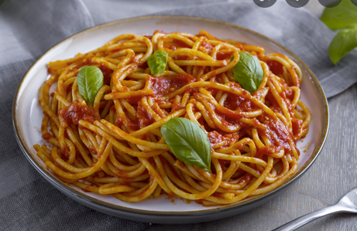
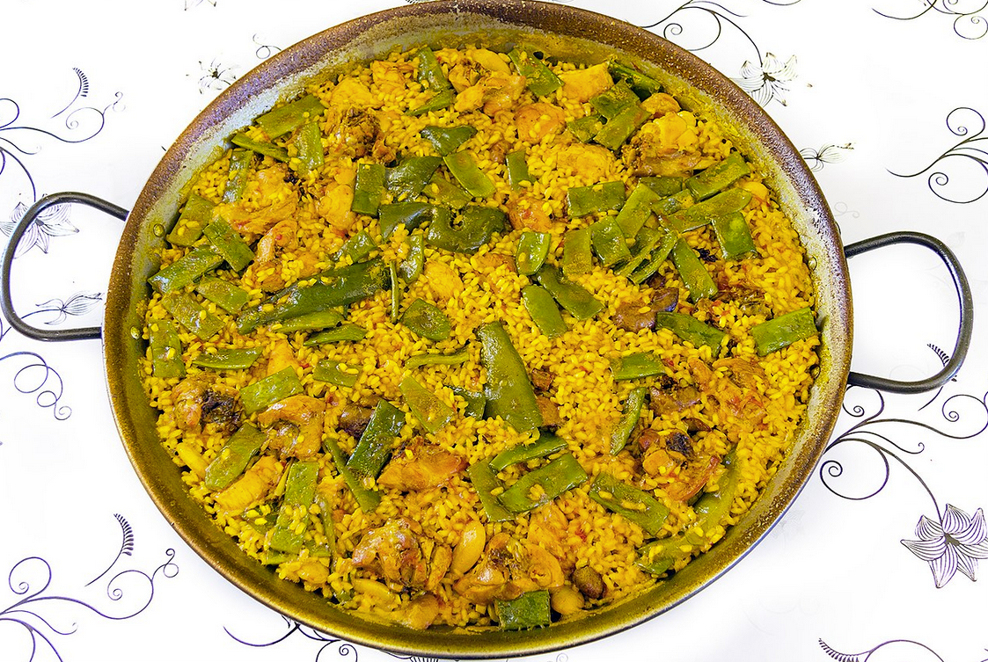
What is a computational model?
It is a mathematical model that defines internal variables.
These unobservable variables are parameterized and change according to the cognitive operations required to solve a task
E.g., deciding what to eat

Slide 4


What is a computational model?
Our choice depends on the value that we assign on each option
$$V^{pasta}=0.50$$
$$V^{paella}=0.50$$

Slide 5


Why do we need a computational model?
$$V^{pasta}=0.50$$
Most concepts of cognition rely on verbal theories, on analogies and metaphor and are thus imprecise. Computational models allow precise mathematical formulation of the theories and specification of assumptions and their implications.
Computational models make us think deeply about the variables involved and their relationship
They allow to formally compare different models based on different assumptions or theories
They allow to estimate trial-level quantities that are not immediately observable
$$V^{paella}=0.50$$

Slide 6

How do we learn these values?
$$V^{pasta}=0.50$$
Trial and error
We start from some expecations about the options
We compare the expectaions of both options (values) and decide for the
better (Action selection)
Prediction error: after action selection, we experience the outcome and
compare it with our expectations to see whether they have been met
Update values/learning: we use expectations violation (prediction error) to
upate expectations and improve expectations in the future
$$V^{paella}=0.50$$
This job looks like a job for reinforcement learning!
= Q+⍺𝛿

Slide 7
What is Reinforcement Learning?
Engineering
A machine learning technique that is different from both supervised and unsupervised learning
Psychology
Incremental learning, pavlovian-learning, trial-and-error learning; action selection based on evaluative feedback
Neuroscience
A formula to derive prediction errors and link it to the activation of single neurons and brain areas (e.g., VTA, striatum)

Slide 8
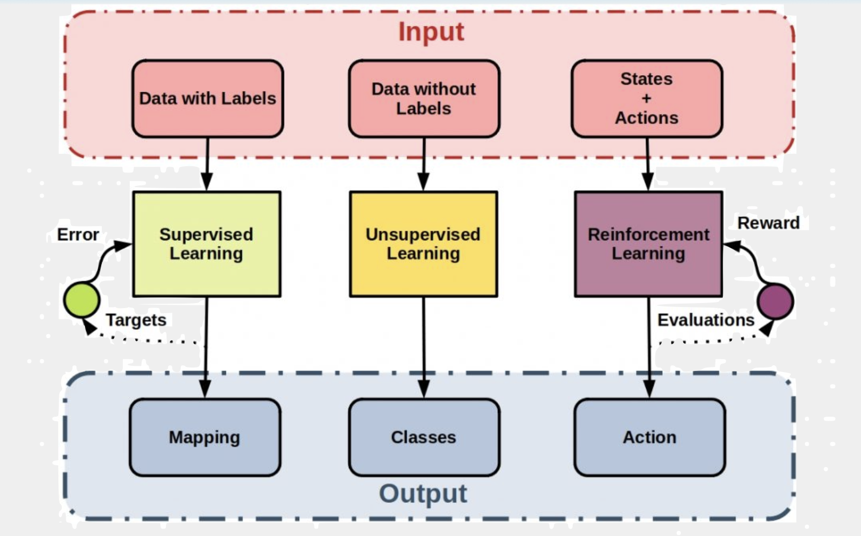
Types of Machine Learning

Slide 9
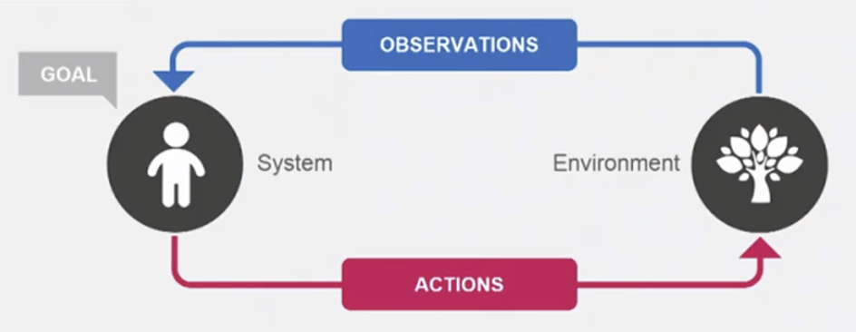
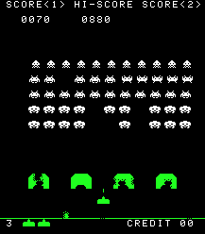
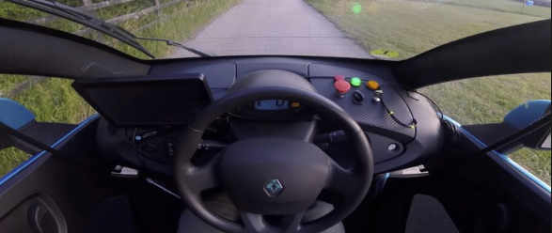
Types of Machine Learning
Supervised Learning
Reinforcement Learning
Pasta
REWARDS
Image classification
After being trained with a great amount of data,
a function learn to map an input (image)
to an output (class)
Learning from experience to pursue goals (maximizing the rewards)
Interact with the environment
Breakthrough in artificial intelligence: Playing Atari games
(Mnih et al (2015) Nature)
and self-driving cars

Slide 10
Types of Reinforcement Learning
Different types of reinforcement learning can be distinguished depending on whether they include Actions and States
Models that assume no state in the environment
No action: Pavlovian Conditioning
Action: Bandit task, instrumental conditioning, reversal learning
Models that assume states in the environment Not covered in this workshop!
e.G Hidden Markov Models

Slide 11

No action: Pavlovian conditioning
Stimulus – stimulus association
e.g. associating a tone (CS) to food (US)
The food is delivered independently of what the agent is doing
The agend responds to expectations formed during learning through a conditioned response (e.g., salivation),
And increasing the expectations of food

Slide 12
Rescorla-Wagner model
It started as a simple model of how US expectations were learned.
It was developed to explain many phenomena
V_{t+1} = V_{t} + ⍺ (R_{t} – V_{t} )
Expected value:
How strongly CS is predictive of US
Prediction error:
Difference between the current expected value and the observation
Learning rate:
To what extend the curent observation is used to update the expected value

Slide 13
Rescorla-Wagner model
V_{t+1} = V_{t} + ⍺ (R_{t} – V_{t} )
Question: what is the main implication of this model?
When does learning occurs and when it does not?
Now Simulate it!
```{r, Pavlovian}
```

Slide 14
Rescorla-Wagner model
Simulate it with different learning rates
V_{t+1} = V_{t} + ⍺ (R_{t} – V_{t} )
```{r, Pavlovian}
```
Check what happens if we add probabilistic reward

Slide 15
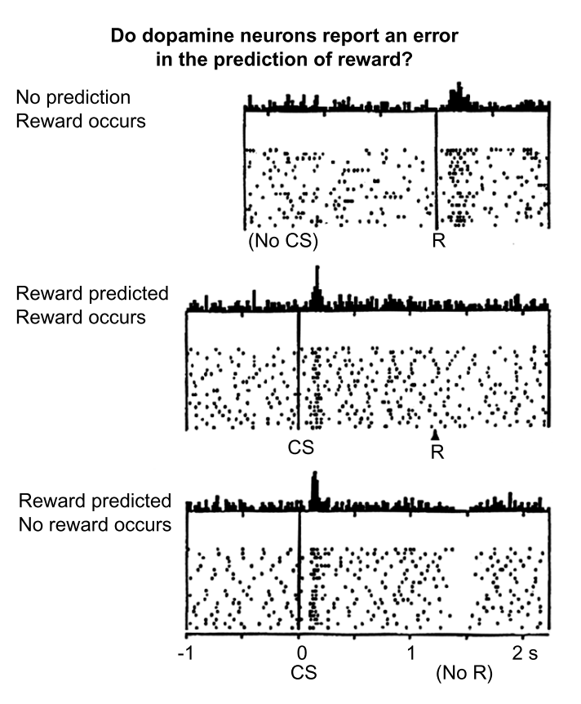
Rescorla-Wagner model
Besides explaining several aspects related to classical conditioning, a slightly modified Rescorla-Wagner model, the Temporal Difference model, was used to derive prediction error which explained
Firing of dopaminergic neurons in the midbrain (﻿Schultz, W. et al. (1997), Science)

Slide 16

Instrumental Learning
In instrumental learning, the agent interacts with the environment to learn how to make the best decisions,
i.e. the ones that maximize the rewards
REWARDS
Two-armed bandit task
Two machine with two different reward probabilities (e.g., 70%, 30%)
The agent learns the reward probabilities by trial and error
Makes the choice depending on a value functions with the goal of maximizing the reward

Slide 17
Instrumental Learning
How does the value function look like?
Two-armed bandit task
Q^{k}_{t+1} = Q^{k}_{t} + ⍺ (R_{t} – Q^{k}_{t} )
Q^{red}_{t+1} = Q^{red}_{t} + ⍺ (R_{t} – Q^{red}_{t})
Q^{yellow}_{t+1} = Q^{yellow}_{t} + ⍺ (R_{t} – Q^{yellow}_{t} )

Slide 18
Instrumental Learning
Q =0.51
Q =0.49
How should the agent choose?

Slide 19
Instrumental Learning
Q =0.51
Q =0.49
1. Always pick the choice with the highest value (exploitation)
```{r, greedy}
```

Slide 20
Instrumental Learning
Q =0.51
Q =0.49
2. Always explore
```{r, explore}
```

Slide 21
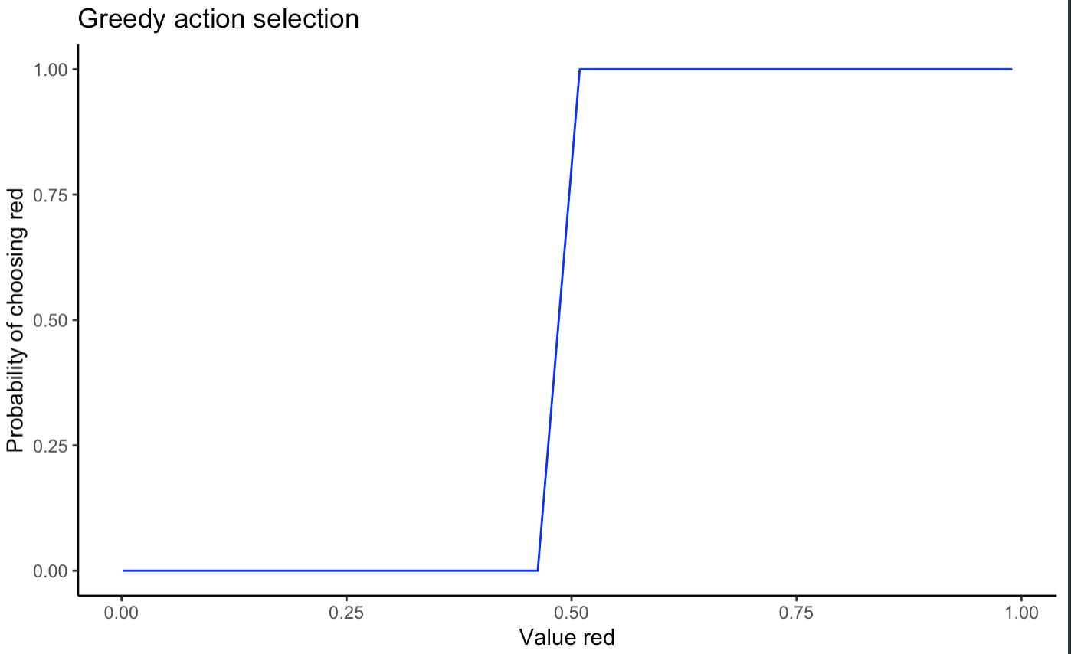
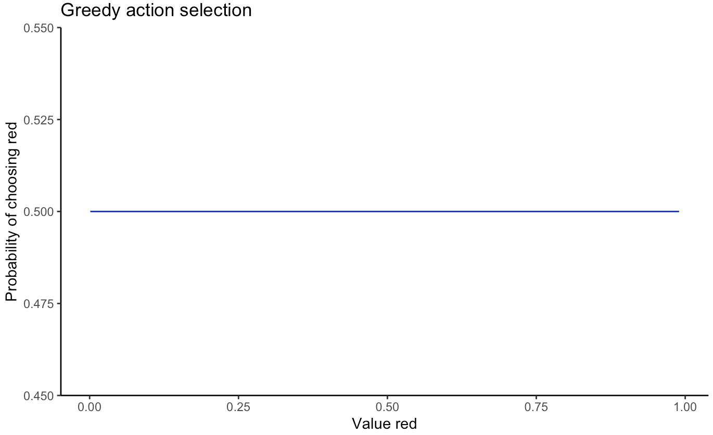
Instrumental Learning
Exploitation vs Exploration dilemma
We can leave it as a free parameter!
(question: can you think of another parameter we have already talked about that can be considered as ”free”?)

Slide 22
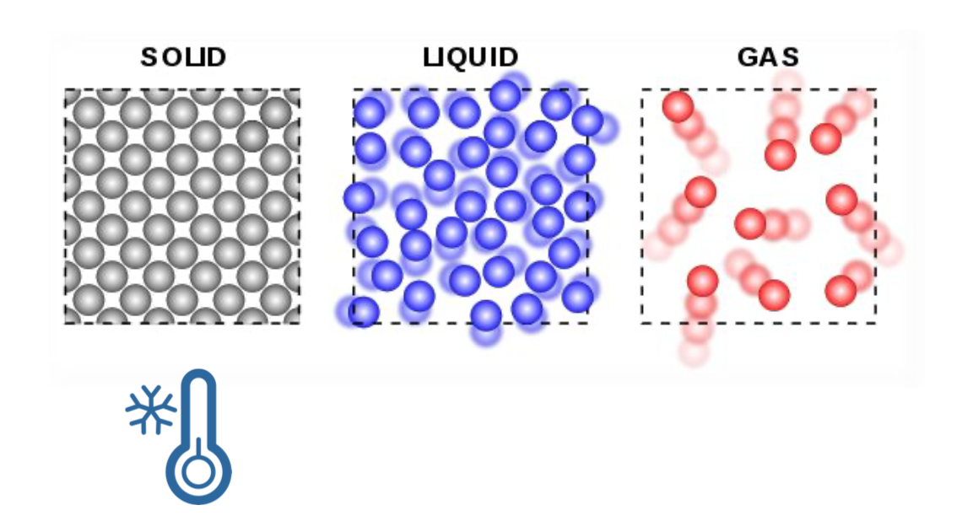
Instrumental Learning
𝞽 = temperature parameter
Low temperature
Choices are less noisy
More affected by value
More deterministic

Slide 23
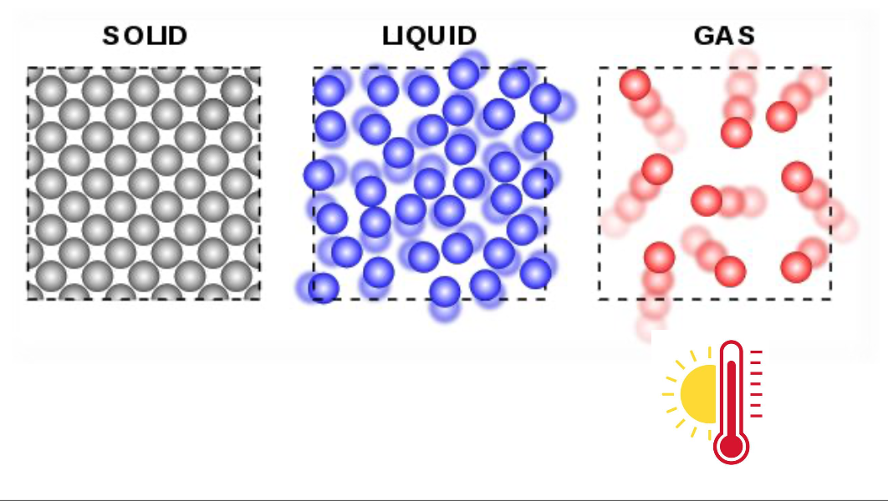
Instrumental Learning
𝞽 = temperature paramenter
High temperature
Choices are more noisy
Less affected by value
Less deterministic
(more stochastic)

Slide 24
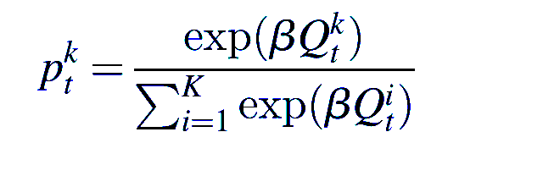
Instrumental Learning
Inverse Temperature : β = 1/𝞽
The higher, the more deterministic the choice will be.
It determines the extent to which value estimates influence choice behaviour
And it also normalizes the Qs
Let’s try to understand it better!
```{r, softmax}
```

Slide 25
Instrumental Learning
Let’s simulate our first instrumental model!
```{r, instrumental simulate}
```
Try to simulate for different parameters
End of the first part!

Slide 26
Part 2 – Model Fitting
CIMCYC Workshop Computational modelling of behavioral data
Granada, 2nd June 2022

Slide 27
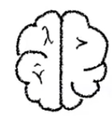

Model Fitting
What we created is a Generative Model
Q^{k}_{t+1} = Q^{k}_{t} + ⍺ (R_{t} – Q^{k}_{t} )
𝜃 = { ⍺ ,β}
_{P(D|𝜃, M) P( 𝜃| M)}

Slide 28
Model Fitting
What we created is a Generative Model
Q^{k}_{t+1} = Q^{k}_{t} + ⍺ (R_{t} – Q^{k}_{t} )
𝜃 = { ⍺, β}
_{Model Inversion}
_{P(D|𝜃, M) P( 𝜃| M)}
_{P(𝜃|D, M)}

Slide 29
Model Fitting
Fitting model to real data

Slide 30
Model Fitting
Design task and model
Simulate model and experiment
Parameter Recovery
Model Recovery
Fitting model to real data
Parameters fit
Model Comparison
Validate the model
Can the model account for the data?
No
Yes
Analyze latent variables and report results

Slide 31
Model Fitting
Design task and model
Simulate model and experiment
Parameter Recovery
Model Recovery
Fitting model to real data
Parameters fit
Model Comparison
Validate the model
Can the model account for the data?
No
Yes
Analyze latent variables and report results

Slide 32
Model Fitting
Design task and model
Simulate model and experiment
Parameter Recovery
Model Recovery
Fitting model to real data
Parameters fit
Model Comparison
Validate the model
Can the model account for the data?
No
Yes
Analyze latent variables and report results

Slide 33
Parameter Recovery
in order to check whether the fitting procedure for each model gave meaningful parameters.
Simulate data with parameters randomly sampled from our parameter space.
Fit the model to the simulated data.
Compared parameters used to simulate the data to the fitted data

Slide 34
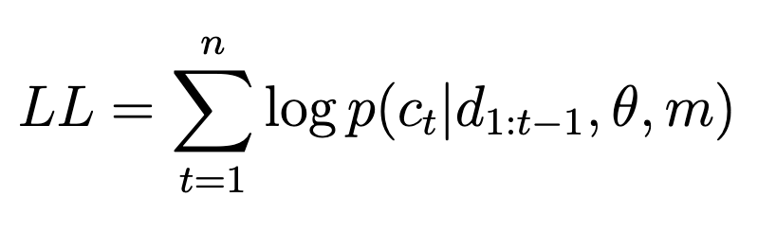
Parameter Recovery
We know how to simulate parameters, but how can we actually fit the model to data?
When we fit model to data we are estimating the parameters that are maximizing the likelihood of
observing those data.
p(c_{t}|d_{1:t−1}, θ, m)= likelihood of observing the data given the parameters and the model
This is estimated as the product of the probabilities, and it is thus usually a small number
To make it more tractable, the logarithm is taken - Log Likelihood
The optim function from R uses optimization algorithms to find the values that minimize each functions:
As it looks for a minimum, we need to feed it the Negative Log Likelihood

Slide 35
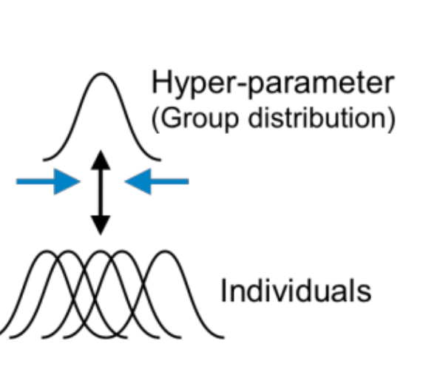
Parameter Recovery
Alternative to Maximum Likelihood: Hierarchical Bayesian Estimation
p(c_{t}|d_{1:t−1}, θ, m)= = likelihood likelihood of observing the data given the parameters and the model
p (c_{t}|d_{1:t−1}, θ, m) * p(θ, m)
P( θ, m| c_{t}, d1_{:t−1}) =

Slide 36
Parameter Recovery
```{r, parameter recovery}
```

Slide 37
Model Recovery
We can show that the model can successfully recover the parameters.
But can the model distinguish between different models that might generate the data?
In order to answer this question, we need to check whether the model can successfully recover the model that generated the data.
Simulate data with different models from our model space.
Fit all the models to the simulated data.
Compare the fit of each models
Ideally, the model that generated the data should have the best fit compared to the others

Slide 38
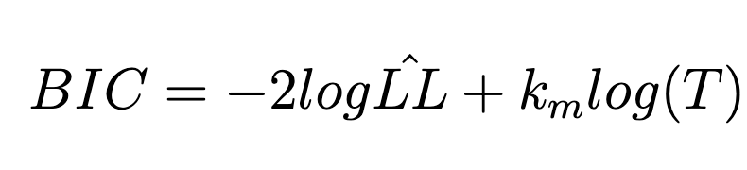
Model Recovery
But how can we compare the fit of different models?
﻿In model comparison, our goal is to figure out which model of a set of possible models is most likely to have generated the data.
Therefore, for each model, we need to compute the probability that the data were generated by a model: p(m|d_{1:t})
The method commonly used is the Bayesian Information Criterion :

Slide 39
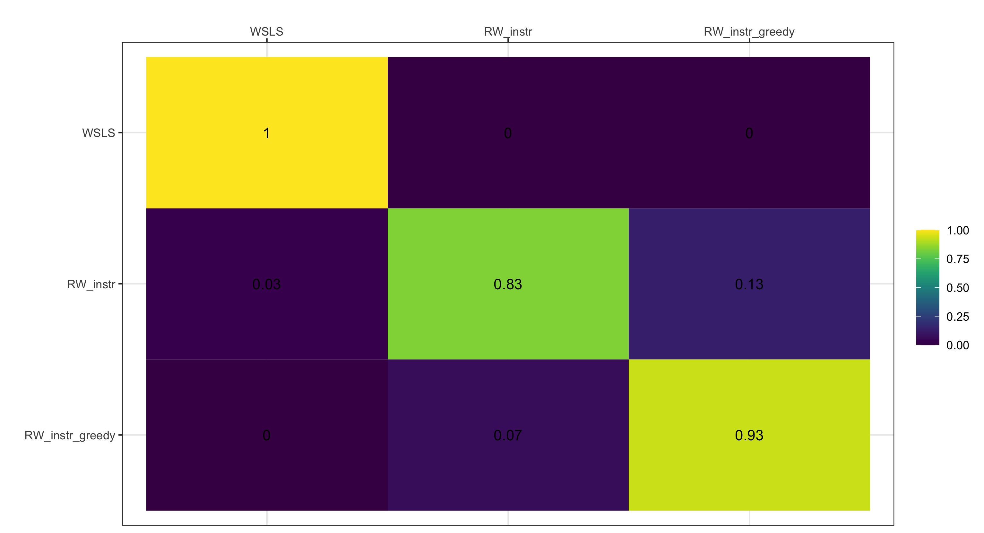
Model Recovery
Fit Model
Simulated Model

Slide 40
Model Fitting
Design task and model
Simulate model and experiment
Parameter Recovery
Model Recovery
Fitting model to real data
Parameters fit
Model Comparison
Validate the model
Can the model account for the data?
No
Yes
Analyze latent variables and report results

Slide 41
Model Fit
Just like what we did in parameter recovery –
When we fit model to data we are estimating the parameters that maximize the likelihood of
observing those data.
```{r, Model fit one participant}
```
```{r, Model fit all participant}
```

Slide 42
Model Comparison
After calculating the BIC, we can count the number of participants for which each model was the best fit.
In addition, We can calculate the ”model evidence”, following Gluth et al. (2017), depending on the difference between the best and the second-best model for each participant.
```{r, Model comparison}
```
Gluth, S., Hotaling, J. M., and Rieskamp, J. (2017). The attraction effect modulates reward16 prediction errors and intertemporal choices. Journal of Neuroscience, 37(2):371–382.

Slide 43
Model Fitting
Design task and model
Simulate model and experiment
Parameter Recovery
Model Recovery
Fitting model to real data
Parameters fit
Model Comparison
Validate the model
Can the model account for the data?
No
Yes
Analyze latent variables and report results

Slide 44
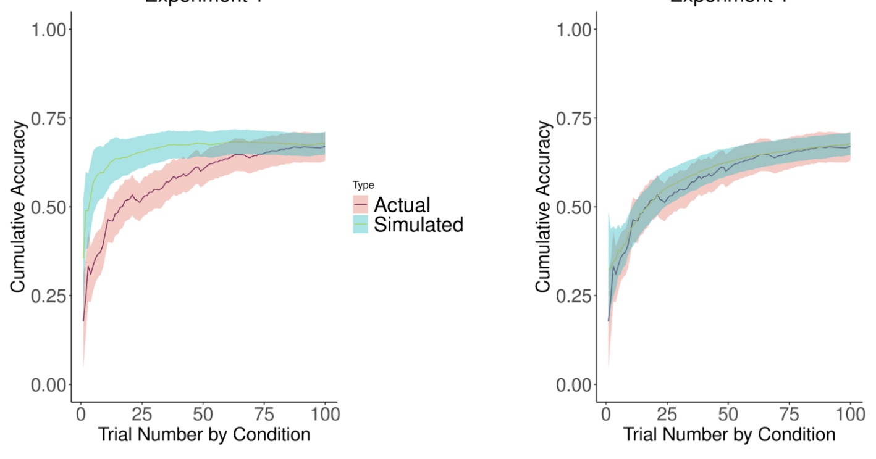
Model Fitting
Validating the model means to check whether data simulated by the model, with the parameters of best fit, replicate pattern observed in the empirical data (posterior predictive check)

Slide 45
Model Fitting
Design task and model
Simulate model and experiment
Parameter Recovery
Model Recovery
Fitting model to real data
Parameters fit
Model Comparison
Validate the model
Can the model account for the data?
No
Yes
Analyze latent variables and report results

Slide 46
Model Fitting
Design task and model
Simulate model and experiment
Parameter Recovery
Model Recovery
Fitting model to real data
Parameters fit
Model Comparison
Validate the model
Can the model account for the data?
No
Yes
Analyze latent variables and report results

Slide 47
Model Fitting
Thank you!
Questions??

Slide 48
Suggested Readings
Sutton, R. S., & Barto, A. G. (2018). Reinforcement Learning: An Introduction, Second Edition. In The Lancet (Vol. 258, Issue 6685). https://doi.org/10.1016/S0140-6736(51)92942-X
Daw, N. D. (2011). Trial-by-trial data analysis using computational models. Decision Making, Affect, and Learning: Attention and Performance XXIII, 1–26. https://doi.org/10.1093/acprof:oso/9780199600434.003.0001
Daw, N. D., & Tobler, P. N. (2013). Value Learning through Reinforcement: The Basics of Dopamine and Reinforcement Learning. Neuroeconomics: Decision Making and the Brain: Second Edition, 283–298. https://doi.org/10.1016/B978-0-12-416008-8.00015-2
Wilson, R. C., & Collins, A. G. E. (2019). Ten simple rules for the computational modeling of behavioral data. ELife, 8, 1–33. https://doi.org/10.7554/eLife.49547

